Slide 1
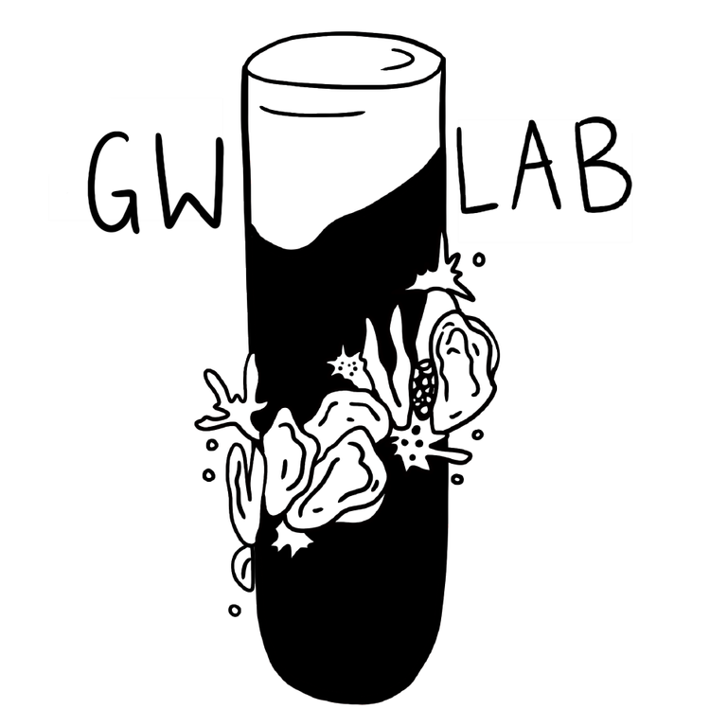


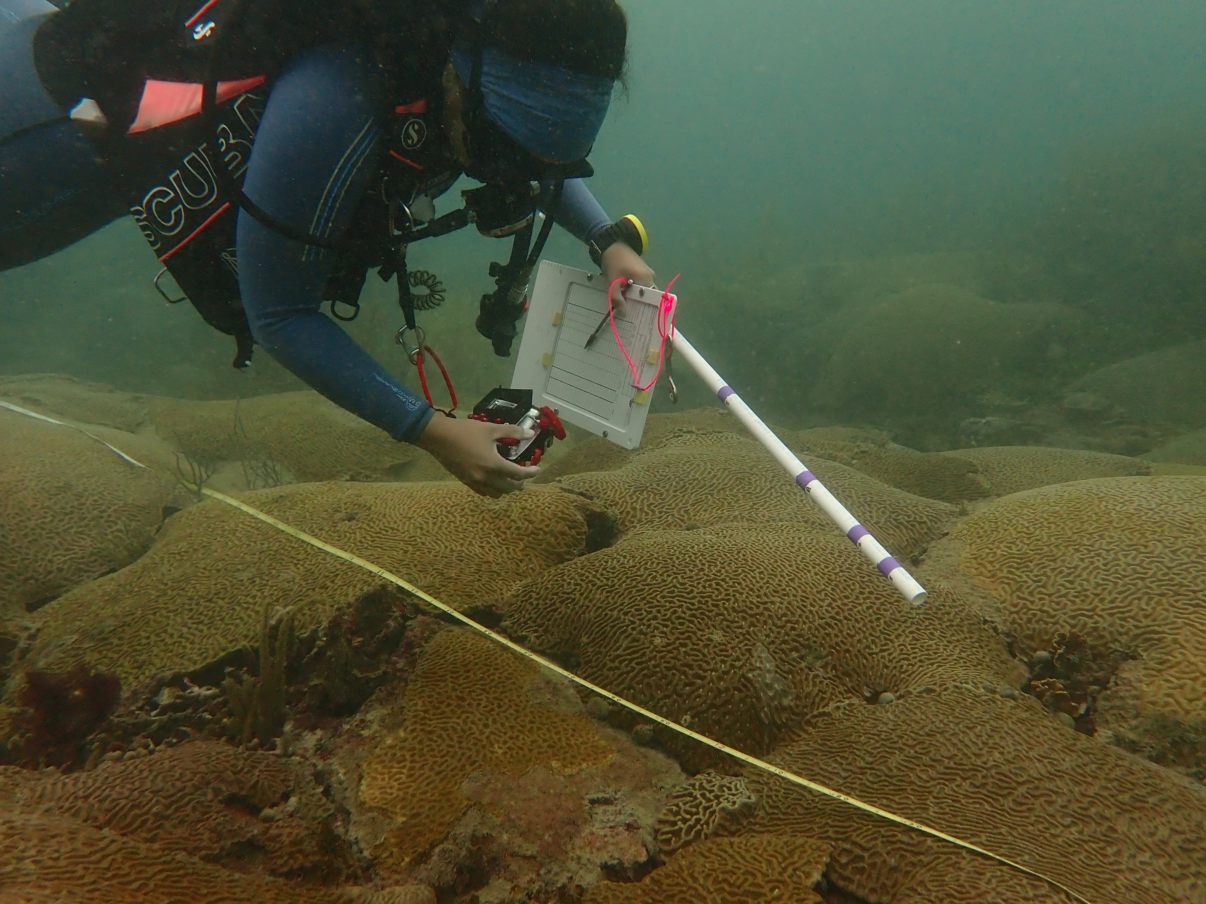

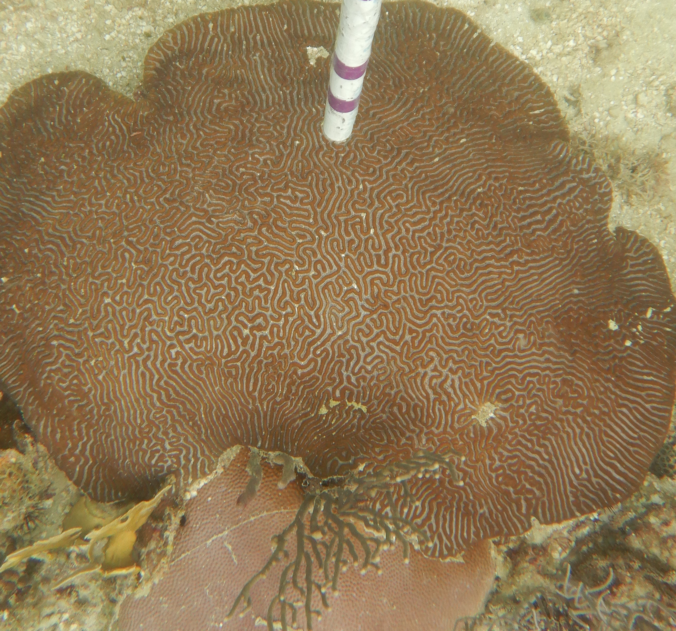
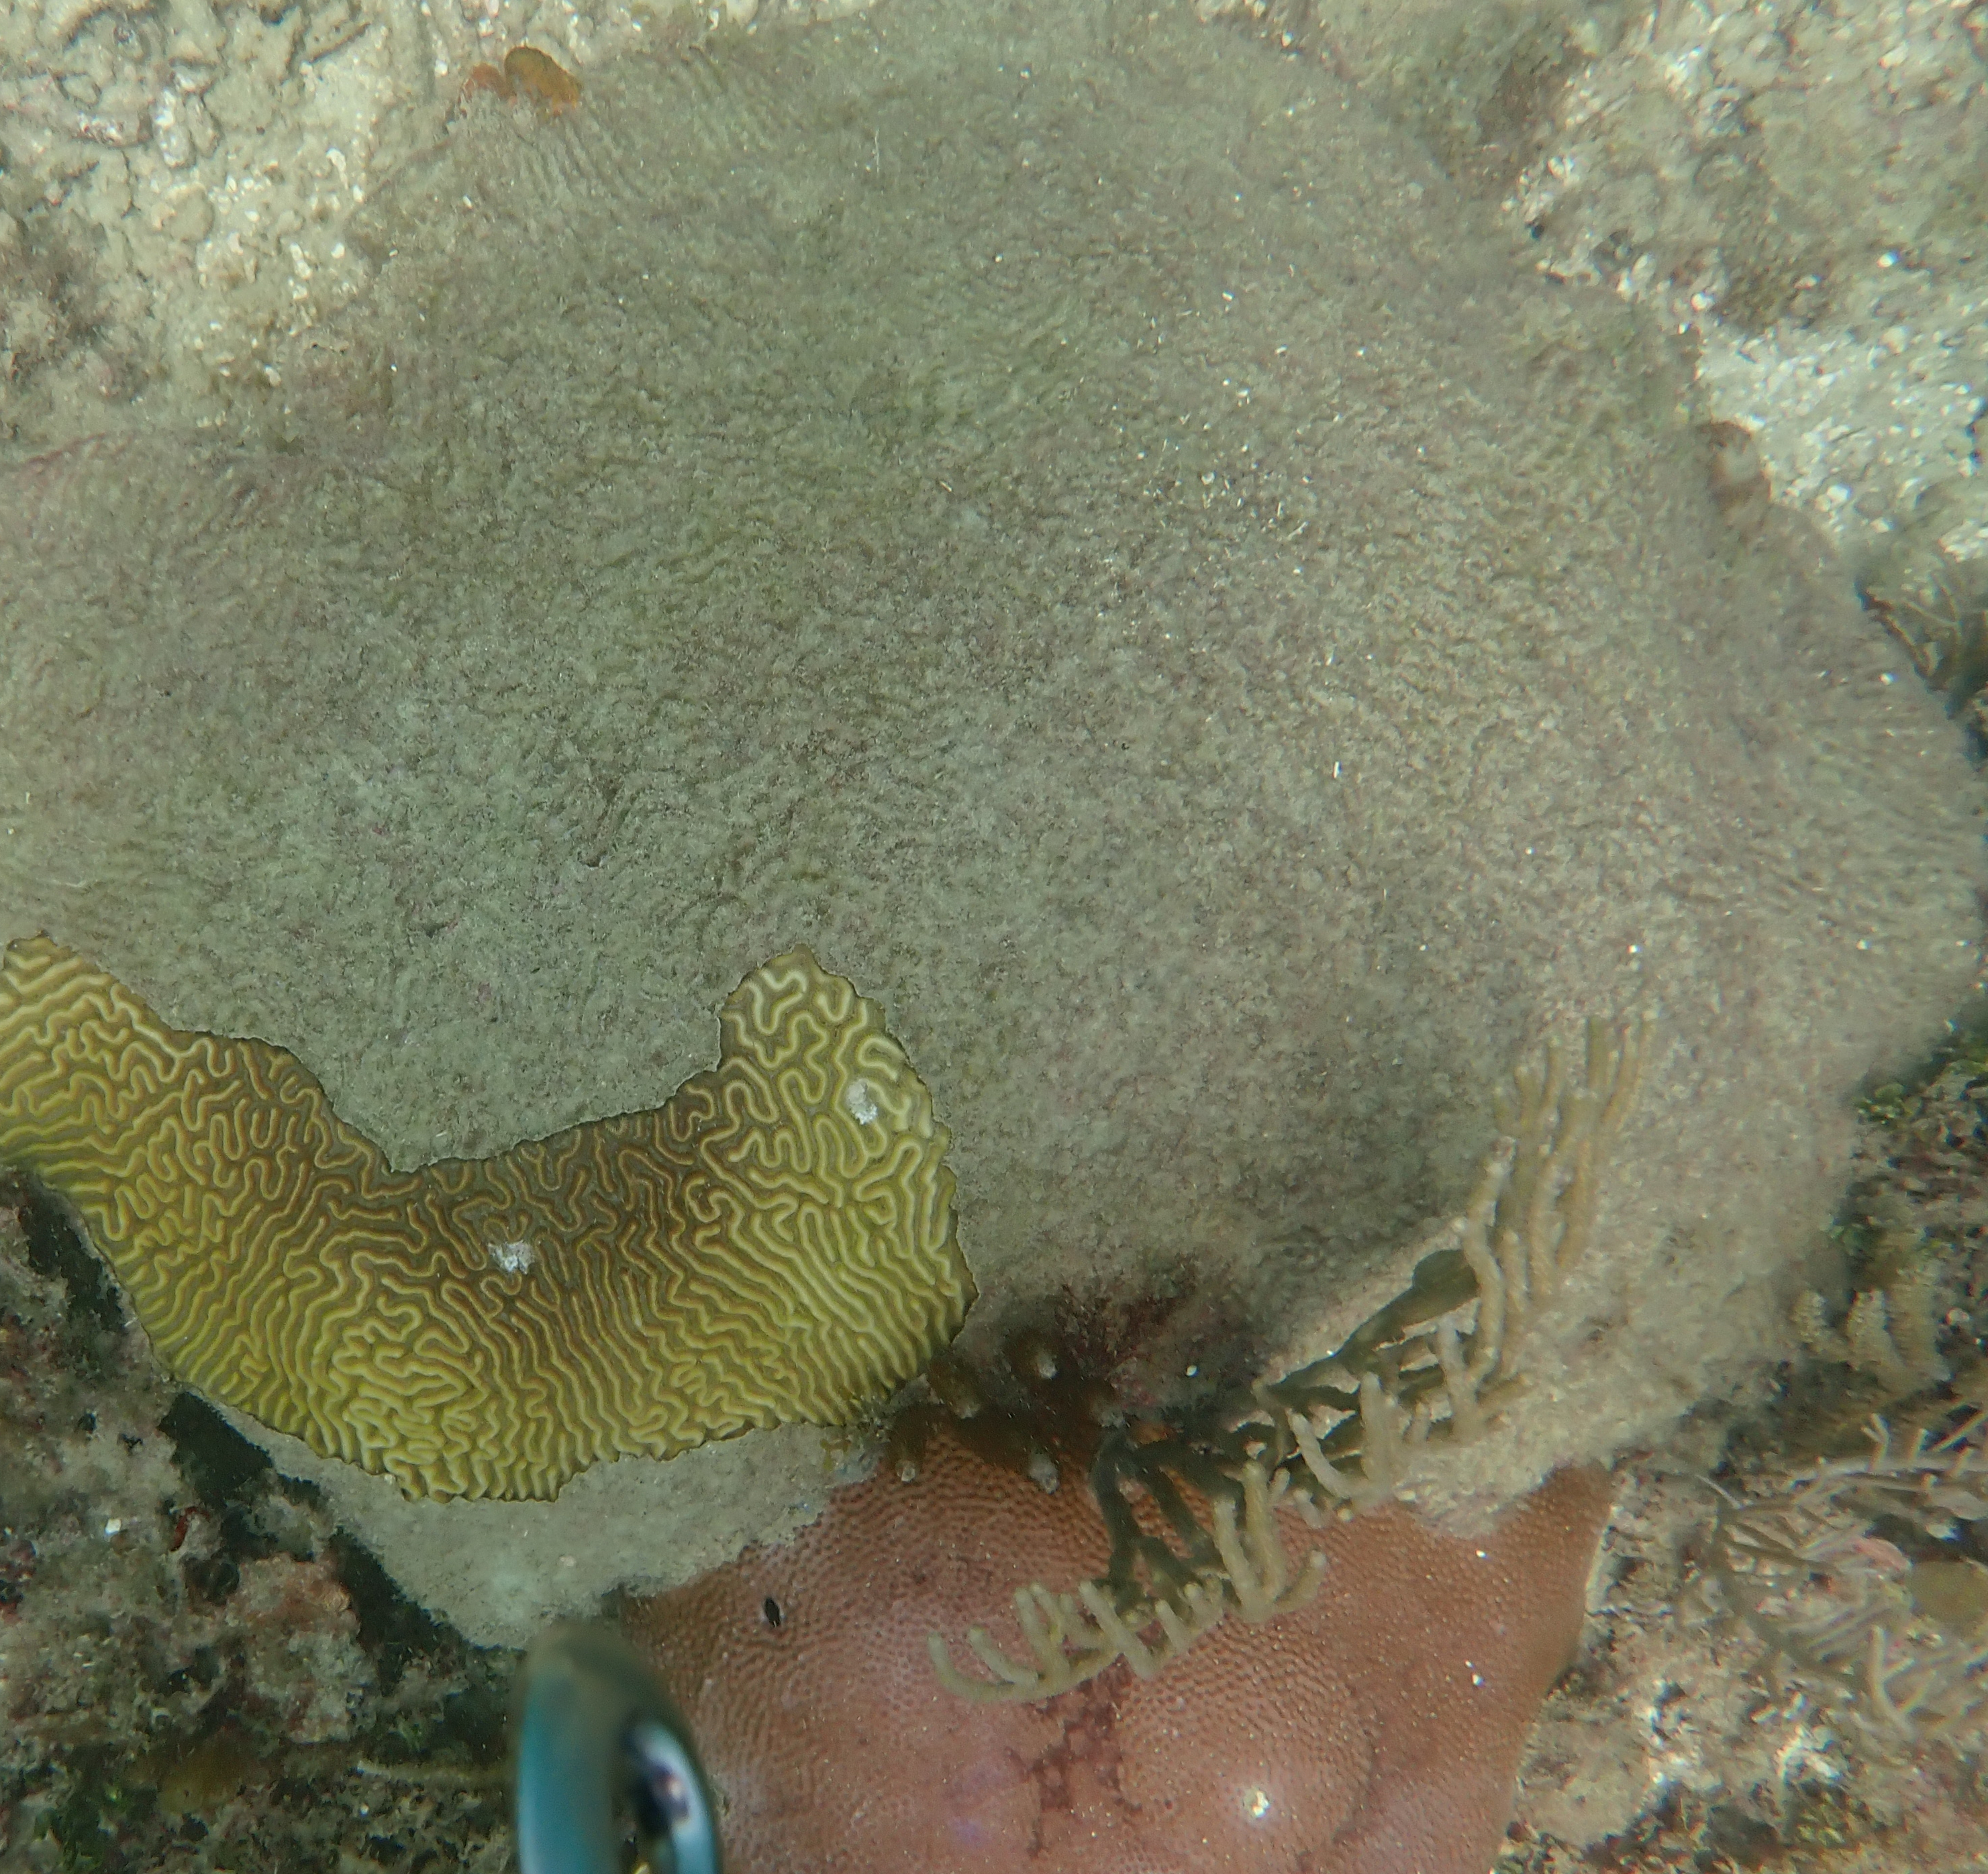
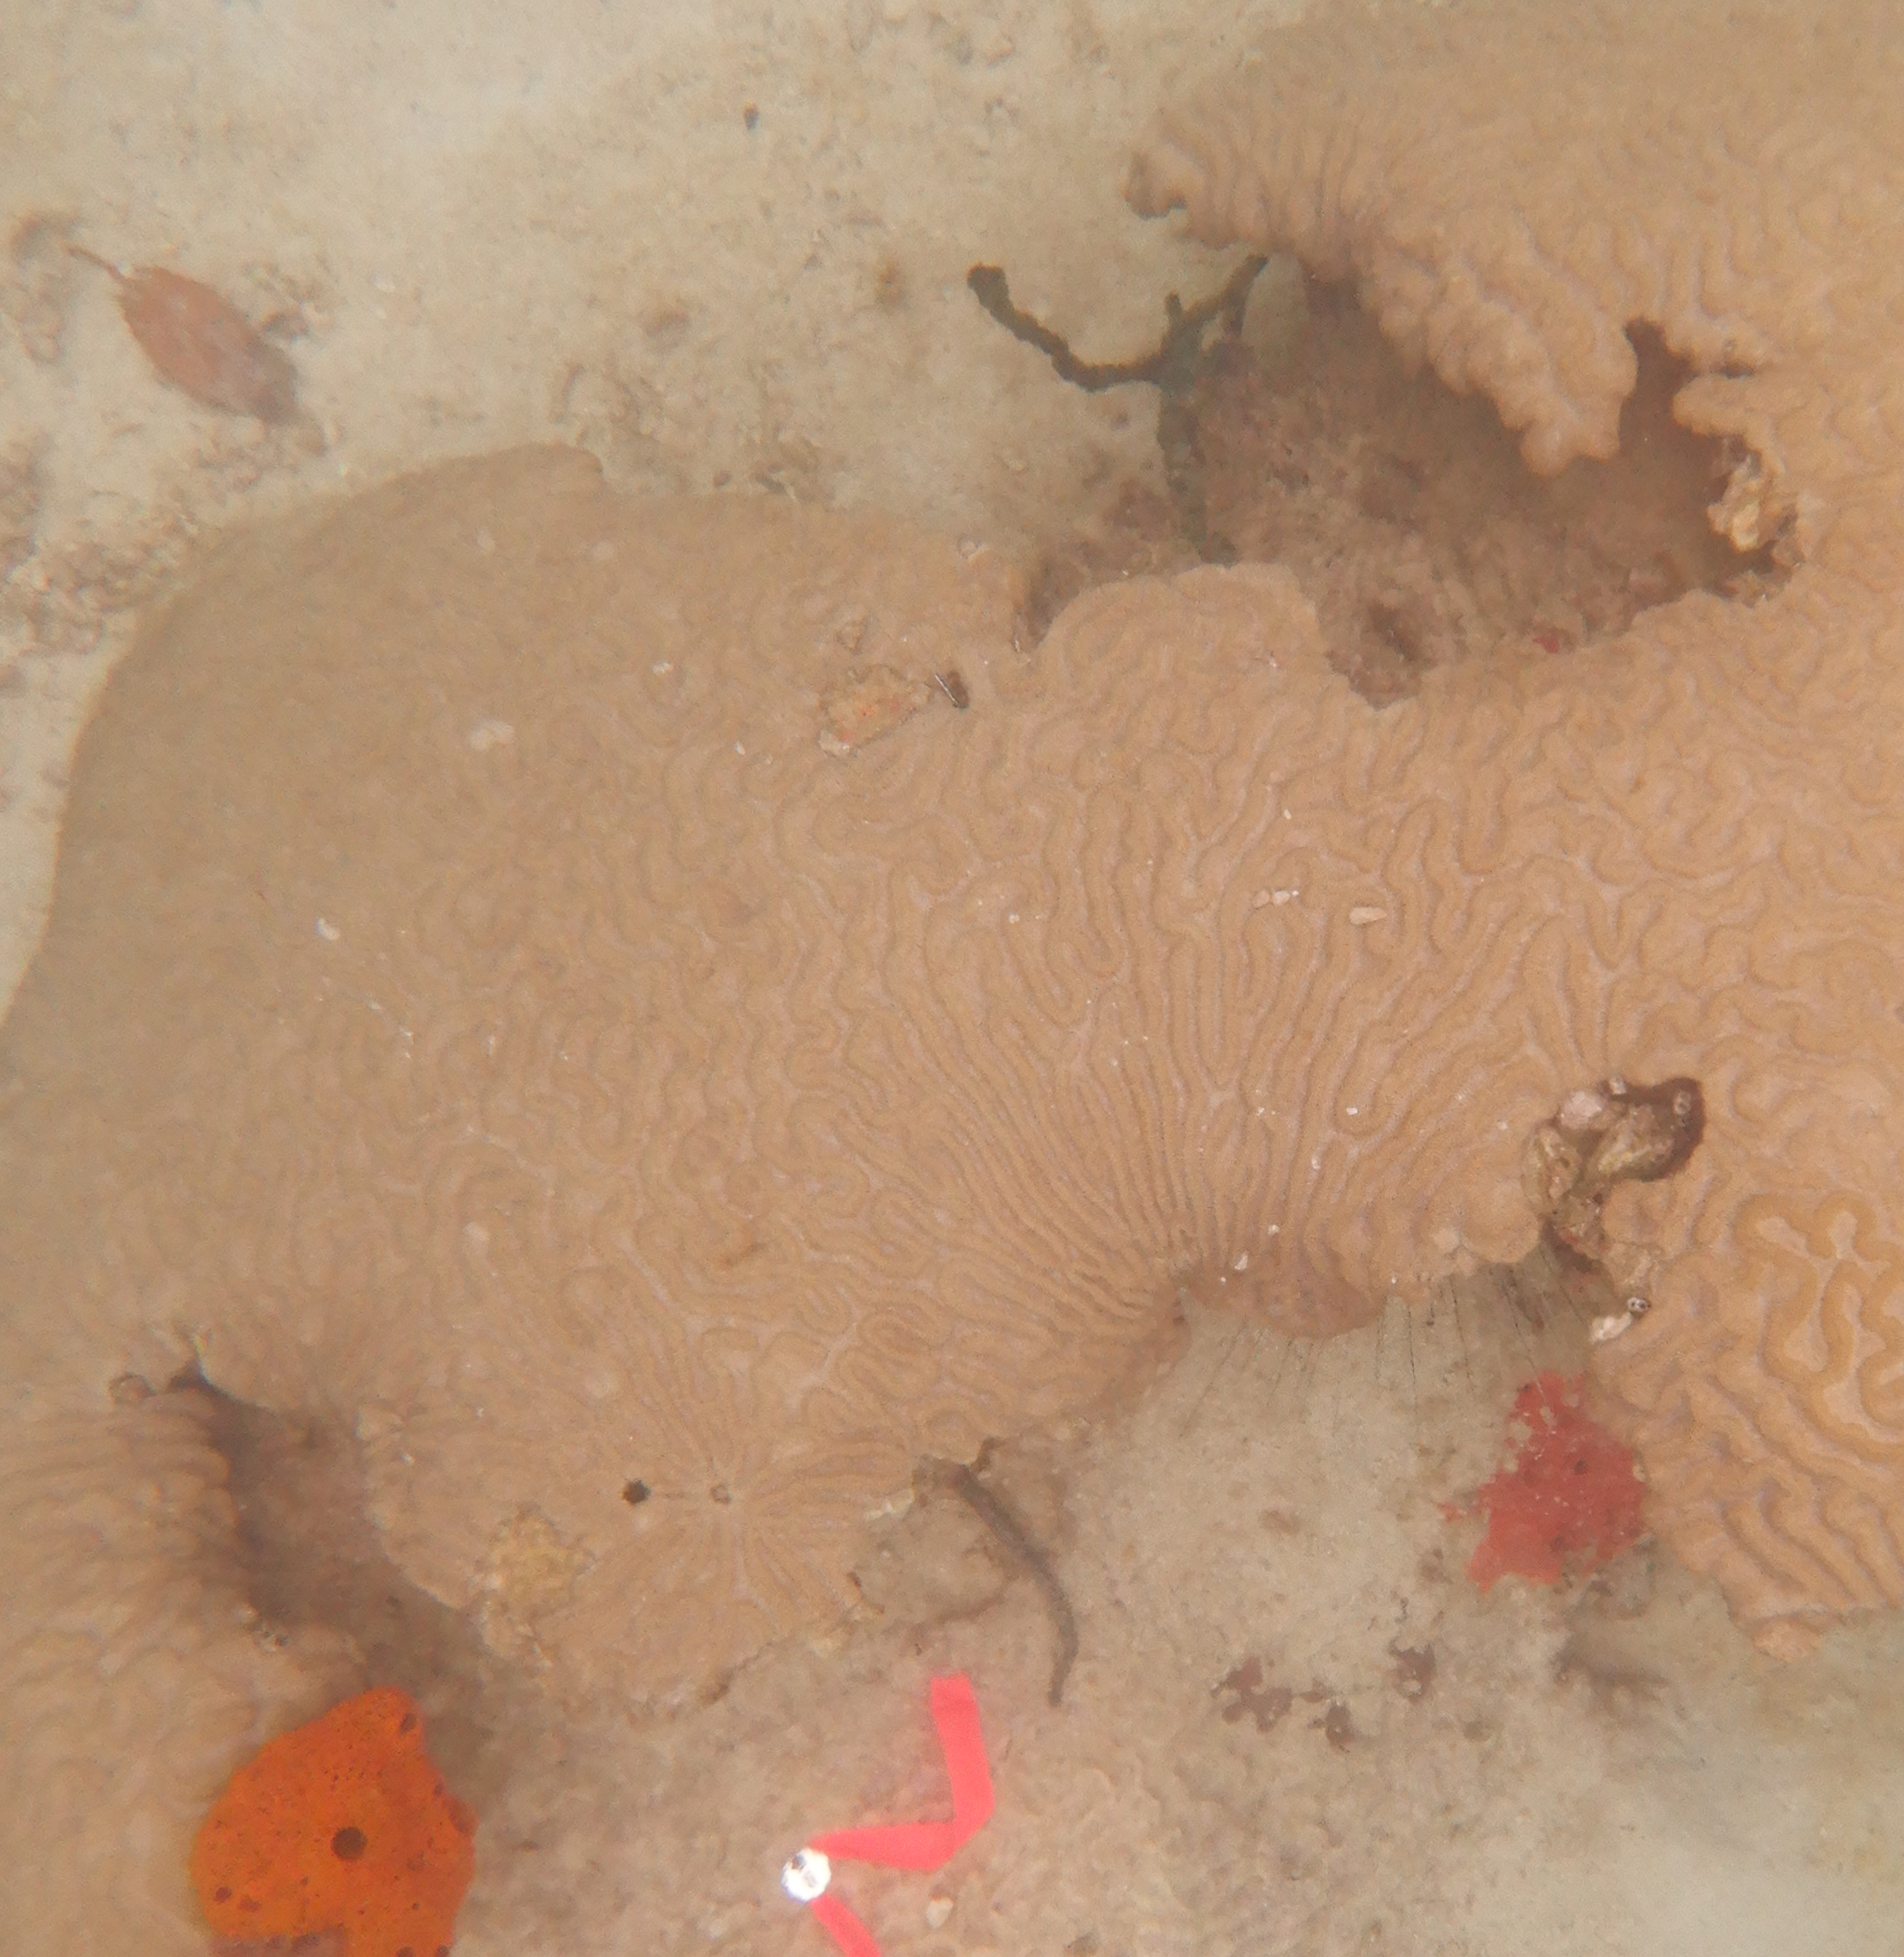
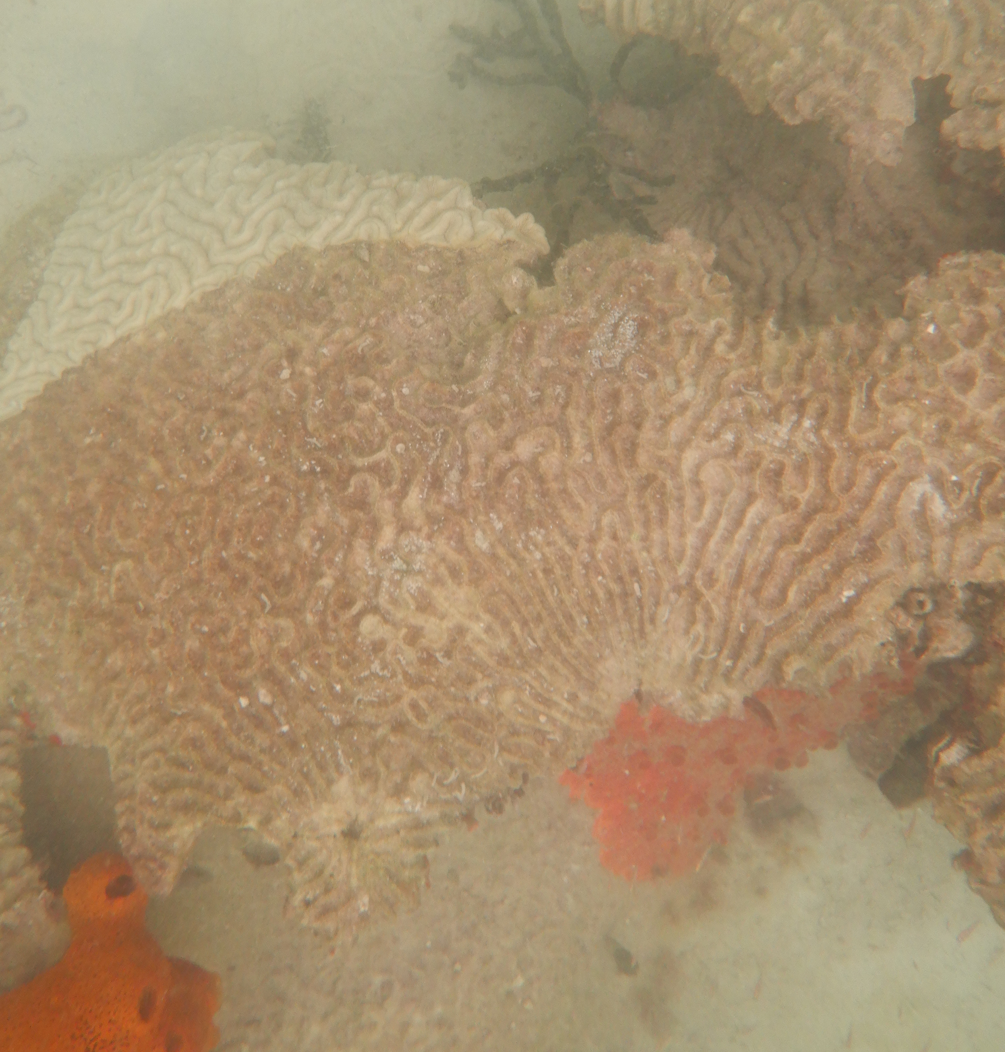
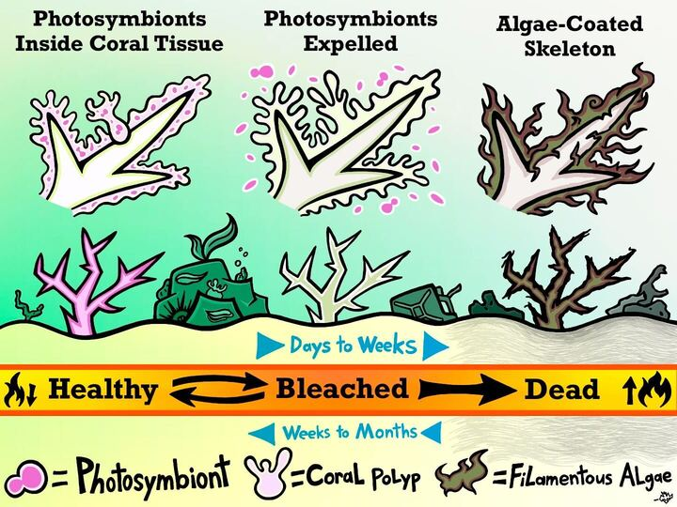
The Ecological Effects of a Marine Heatwave on Panamanian Coral Reefs
Caroline DeSouza, Felicia Aronson, Leah Harper, Brooke Sienkiewicz & Sarah Gignoux-Wolfsohn Department of Biological Sciences, University of Massachusetts Lowell
Introduction
Heatwaves alter the state of balance in marine ecosystems, straining organism interactions. Corals are particularly vulnerable to changes in the marine environment as they are holobionts, relying on support from their microbiome; which includes photosynthetic algae as a source of autotrophic energy.
Unprecedented elevated temperatures were recorded in Caribbean Sea during the Fall of 2023. This heatwave induced a massive bleaching event in the region, causing corals to expel their algal symbionts.
Methodology
Conclusion
Several colonies are unable to recover algal symbionts, leading to eventual tissue death
Coral polyps can temporarily sustain themselves during bleaching events by feeding on dissolved organic matter
Colpophyllia natans (CNAT) are extremely susceptible to bleaching and subsequent tissue death, suggesting that their symbionts are less resilient to
increased temperatures
Tagged corals at three reefs in Bocas del Toro, Panama
Surveyed & photographed tagged coral colonies at three time points
Analysis of coral health status over time.
Dplyr, tidyverse, ggplot2, ggsankey
Results
During Marine Heatwave
All PSTR colonies observed to have some bleaching
Other species were more successful in resisting active bleaching
Post-Marine Heatwave
Majority of CNAT and PSTR colonies experienced tissue death
SSID, MCAV, & ORBI spp. were able to recover algal symbionts
Sep_2022 Jul_2024
Sep_2022 Jul_2024
PSTR CNAT
Future Directions
ITS2 DNA metabarcoding to quantify symbionts across coral host species
Utilizing Belizean coral samples from 2019-2024
Explore bleaching recovery and changes in recruited algae
Continued observation of Panamanian corals and an in-situ experiment
Light exposure manipulation on out planted corals
Drawn by Christian Flaherty
Objectives
To continually observe and document the health statuses of coral reefs in Panama through and following a marine heatwave
To compare coral bleaching patterns across host species
Acknowledgements
Thank you to the Smithsonian Tropical Research Institute at Bocas del Toro, Smithsonian MarineGEO, Carolina César Ávila, The Sea of Change Foundation, and Life on a Sustainable Planet
Notes:
Sjoberg, David (2021) ggsankey [Source Code]. https://github.com/davidsjoberg/ggsankey
Osinga, R., Schutter, M., Griffioen, B., Wijffels, R. H., Verreth, J. A., Shafir, S., Henard, S., Taruffi, M., Gili, C., & Lavorano, S. (2011). The biology and economics of Coral Growth. Marine Biotechnology, 13(4), 658–671. https://doi.org/10.1007/s10126-011-9382-7
Brandt, M. E. (2009). The effect of species and colony size on the bleaching response of reef -building
corals in the Florida keys during the 2005 Mass Bleaching Event. Coral Reefs, 28(4), 911–924.
https://doi.org/10.1007/s00338-009-0548-y

